Slide 1

Robo-Soccer & Manipulator

Slide 2
Problem Statement (Robo-soccer)
In Robo-soccer challenge, two manually controlled robots will compete against each other in an arena which resembles an actual soccer field. The robot should be wirelessly controlled. The robot should have been fabricated, assembled by the team. Readymade robots are not allowed.
Specifications of Arena:
Dimensions of Arena are: 240cm*120cm.
The playground is considered flat if a ball placed anywhere on the field does not start to roll.
The goal is 30cm wide and 15cm high.
Specifications of Bot:
At any point of time and any configuration of the bot, it should fit inside a box with horizontal cross section of 20cm*20cm*20cm (l*b*h).
Bot must not exceed weight limit of 5 Kgs.
Bot must have an active ball kicking/pushing mechanism.

Slide 3

Components used :
Arduino MEGA & Nano
L298 Motor drivers
Wireless transceiver nRF24L01
Solenoid & MOSFET
Wheels
Acrylic sheet (3 mm)
Lithium battery (12 V)
Jumpers
300 rpm DC motors
IRF520 MOSFET Driver Module
Universal PCB board (8*12 cm) and breadboard
PS2 Joystick Module breakout sensor
Push Button switch

Slide 4
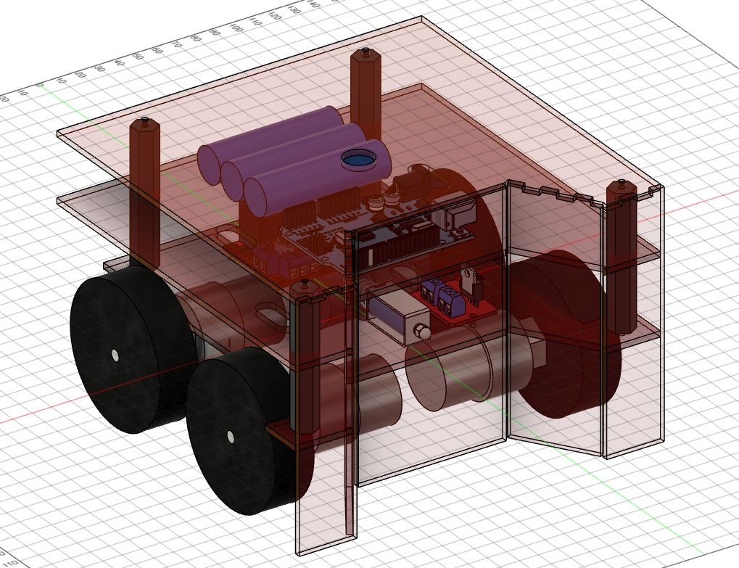
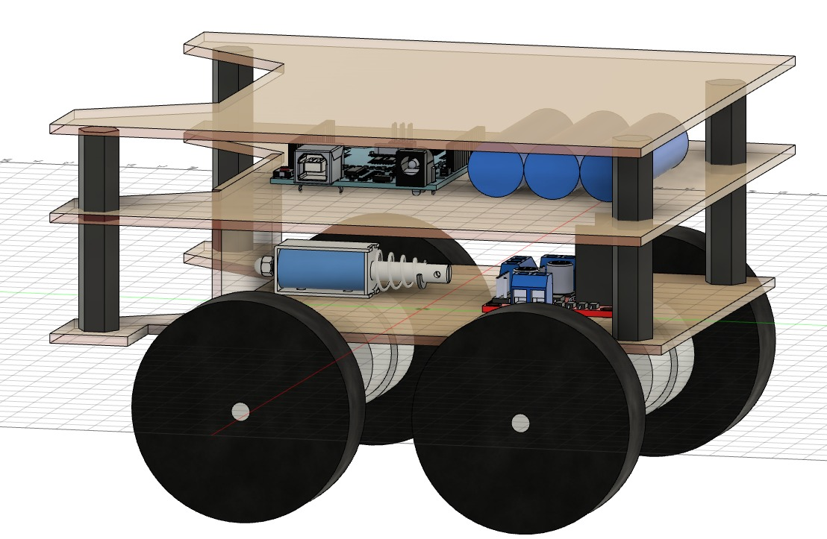
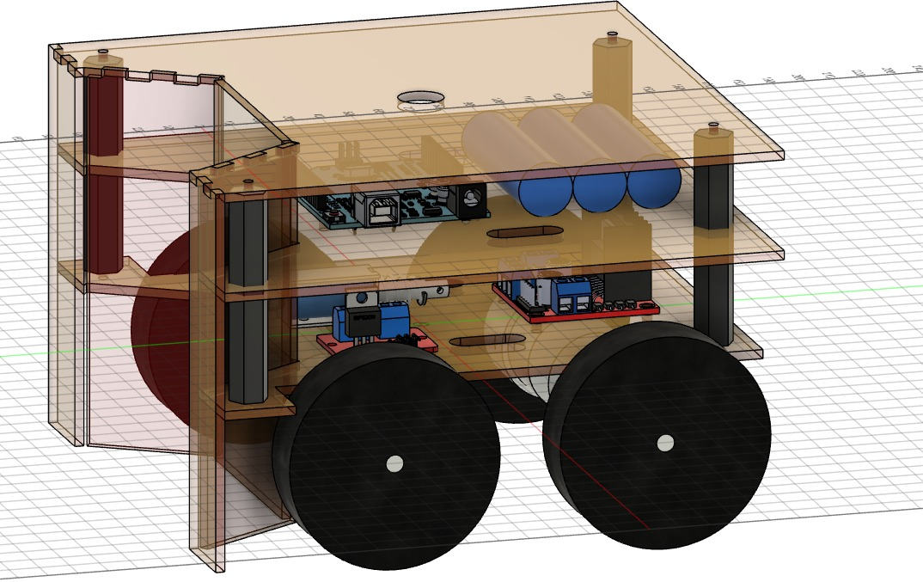
Design of bot:

Slide 5
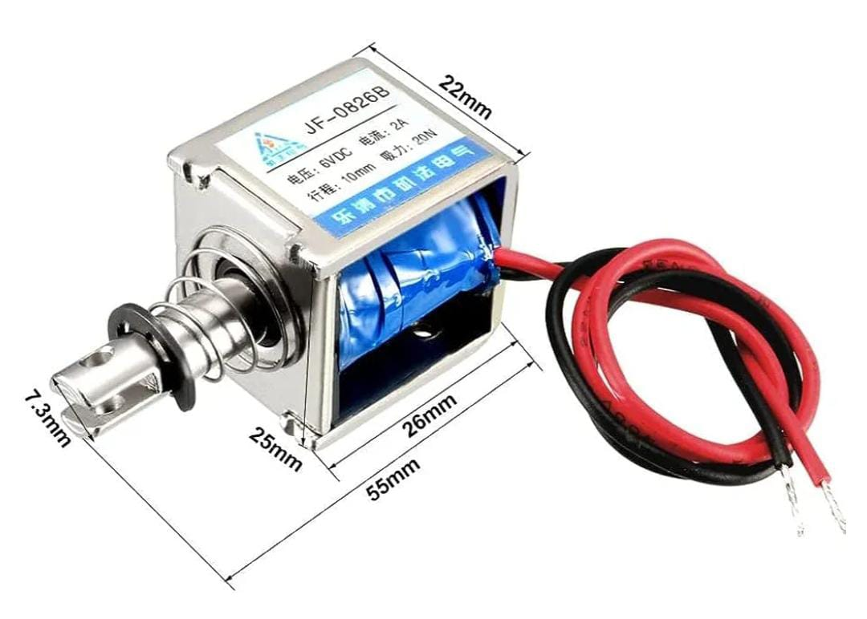
Robot spec in detail :
Mechanics : Navigation-Wheels & Motors
Chassis : This is very important part of the robot which gives shape & stability to robot . The material which was used is a Plastic Material called ACRYLIC (thickness 3mm) which can be easily cut using cutters or LASER and modified to any shape. Attachment of chassis, motors, wheels, electronics was done using nuts & bolt(M3*10mm, M3*50mm & M3*20mm) together with M3*15mm & M3*20mm female to female Hex spacers.
Kicking Mechanism:
It is the most essential part of the bot as the robot must be able to kick the ball with maximum power and with control. This proved more difficult to construct than anticipated. First of all kicking mechanism is a very time consuming part to construct and evaluate and secondly if it is not powerful enough to shoot correctly, it is of no use.
Keeping all these minds we decided to use a solenoid for kicking purpose. Solenoid would generate a push that would ultimately kick the flap of acrylic at a particular spot and it would serve the purpose of KICKER.

Slide 6
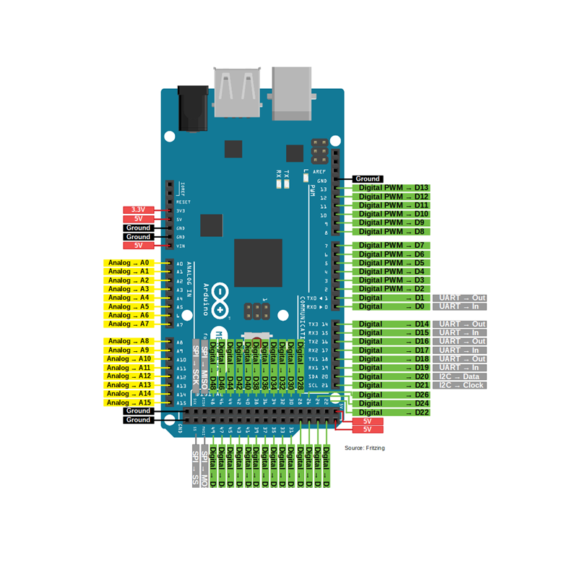
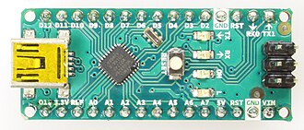
Electronics :
Controller :
Arduino Mega 2560 is an open source development board based on Atmega2560 AVR microcontroller. This microcontroller is an 8- bit Microcontroller. It uses ATmega16U2 Microchip Technology. This board can be programmed using programmed using wiring/ processing language. It includes:-
54 digital input/ output pins out of which 14 pins can be used as PWM outputs
16 analog pins
4 UARTs (hardware serial ports)
A 16 MHz crystal oscillator
A USB connection
A power Jack
An ICSP Header
A reset button
The Arduino Nano is an open-source breadboard friendly microcontroller board based on the Microchip ATmega328P microcontroller (MCU) and developed by Arduino.cc and initially released in 2008. It offers the same connectivity and specs of the Arduino Uno board in a smaller form factor.^{[1]}
The Arduino Nano is equipped with 30 male I/O headers, in a DIP-30-like configuration, which can be programmed using the Arduino Software integrated development environment (IDE), which is common to all Arduino boards and running both online and offline. The board can be powered through a type-B mini-USB cable or from a 9 V battery.

Slide 7
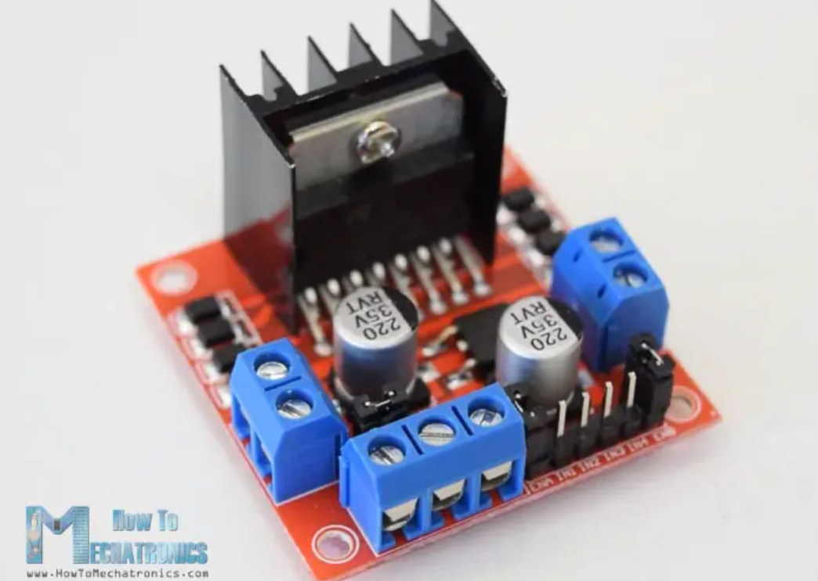
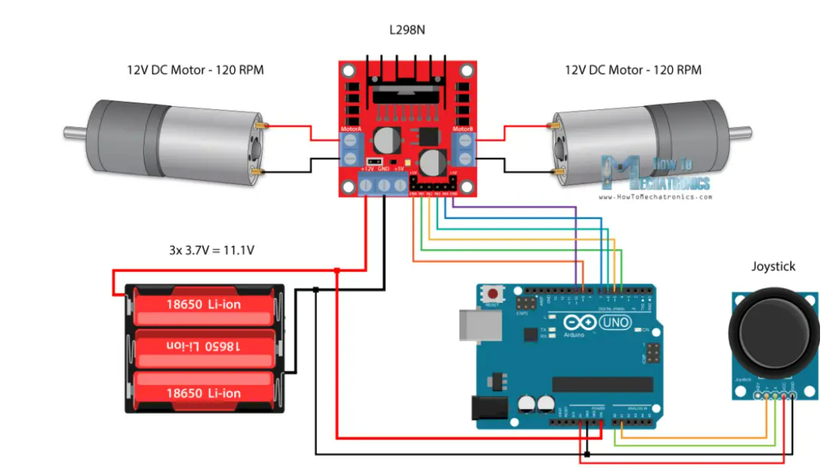
Motor driver :
The L298N is a dual H-Bridge motor driver used for controlling two DC motors simultaneously. It can handle motor voltages between 5V and 35V, with a peak current of up to 2A. The module has screw terminal blocks for connecting the motor A and B, a ground pin, and a VCC pin for the motor supply voltage.
It has an onboard 5V regulator, used as an output when motor voltage is ≤12V, else an input. "Enable A" and "B" pins control motor speed with a jumper for max speed or PWM input for control. "Input 1" and "2" control motor A's direction; "Input 3" and "4" control motor B's direction. Same inputs halt motors.
Arduino and L298N Motor driver :
Link :
Arduino code

Slide 8
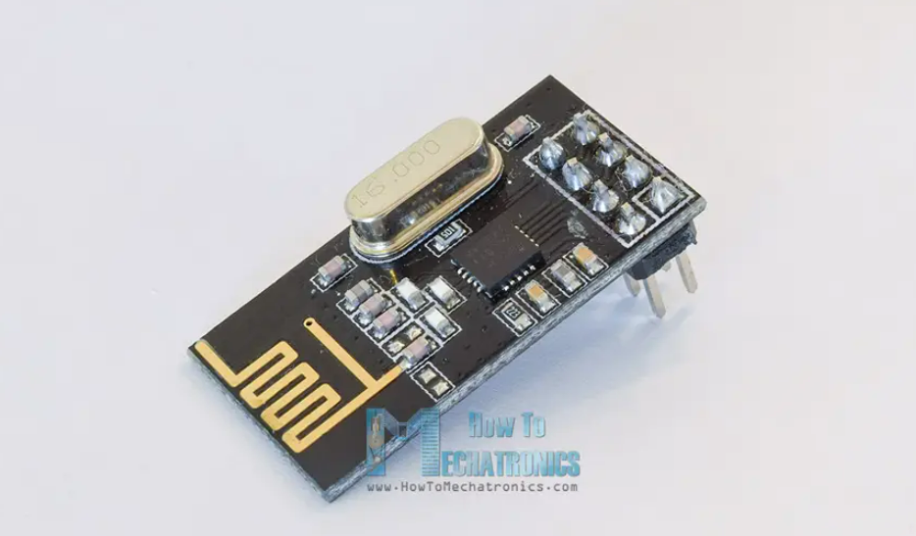
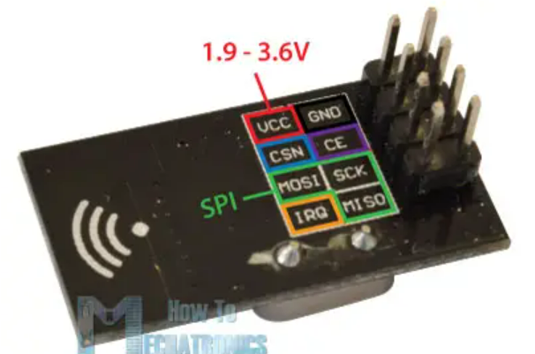
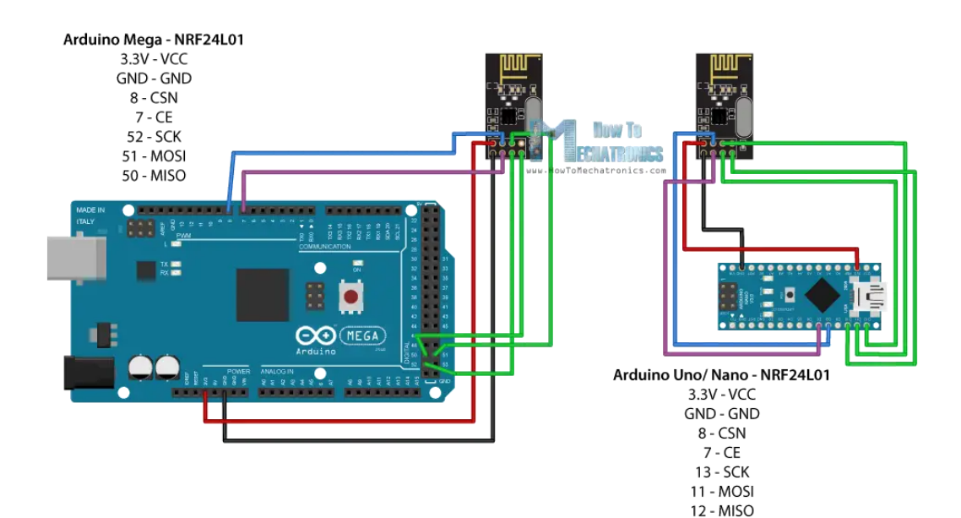
nRF24L01 Transceiver Module :
It uses the 2.4 GHz band and it can operate with baud rates from 250 kbps up to 2 Mbps. If used in open space and with lower baud rate its range can reach up to 100 meters.
The module can use 125 different channels which gives a possibility to have a network of 125 independently working modems in one place. Each channel can have up to 6 addresses, or each unit can communicate with up to 6 other units at the same time.
The power consumption of this module is just around 12mA during transmission, which is even lower than a single LED. The operating voltage of the module is from 1.9 to 3.6V, but the good thing is that the other pins tolerate 5V logic, so we can easily connect it to an Arduino without using any logic level converters.
Connecting the nRF24L01 to Arduino :

Slide 9
Arduino and nRF24L01 Code :
Once we connect the NRF24L01 modules to the Arduino boards we are ready to make the codes for both the transmitter and the receiver.
First we need to download and install the RF24 library which makes the programming less difficult. We can also install this library directly from the Arduino IDE Library Manager. Just search for “rf24” and find and install the one by “TMRh20, Avamander”.
Example: ref. Dejan Nedelkovski, www.HowToMechatronics.com
Receiver Code
#include <SPI.h>
#include <nRF24L01.h>
#include <RF24.h>
RF24 radio(7, 8); // CE, CSN
const byte address[6] = "00001";
void setup() {
Serial.begin(9600);
radio.begin();
radio.openReadingPipe(0, address);
radio.setPALevel(RF24_PA_MIN);
radio.startListening();
}
void loop() {
if (radio.available()) {
char text[32] = "";
radio.read(&text, sizeof(text))
; Serial.println(text);
}
}
Transmitter Code
#include <SPI.h>
#include <nRF24L01.h>
#include <RF24.h>
RF24 radio(7, 8); // CE, CSN
const byte address[6] = "00001";
void setup() {
radio.begin();
radio.openWritingPipe(address);
radio.setPALevel(RF24_PA_MIN);
radio.stopListening();
}
void loop() {
const char text[] = "Hello World";
radio.write(&text, sizeof(text)); delay(1000);
}
remote
Link for code :

Slide 10
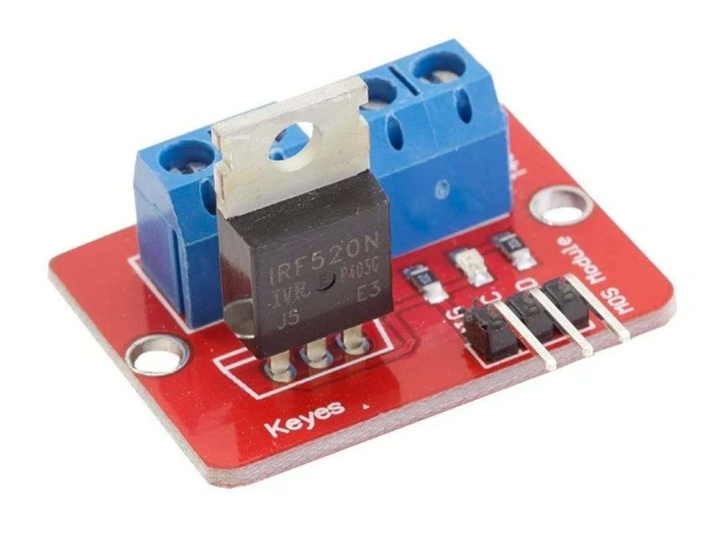
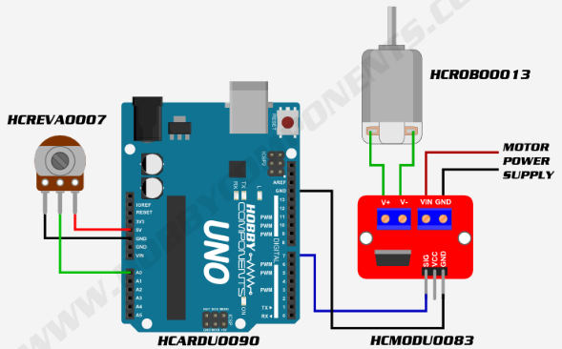
Kicker Power :
The solenoid is an electromagnet. The metal rod in the center is called an armature. It will be drawn into the solenoid when power is applied to the coil. When power is cut, the spring will return the armature to its starting position. The solenoid draws 1.1A which is much more than the GPIO pins on the Feather can source or sink. Therefore, a logic level N-channel MOSFET will be used to drive the solenoid.
Controlling Solenoid :
Solenoid
Above circuit shows connection for motor but same can be used for solenoid

Slide 11
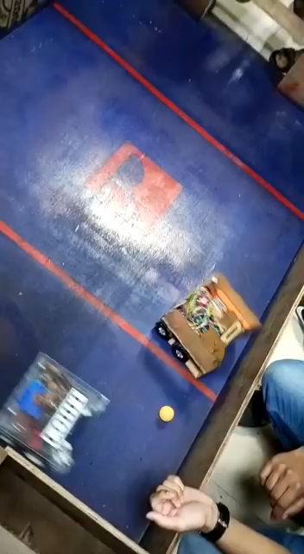
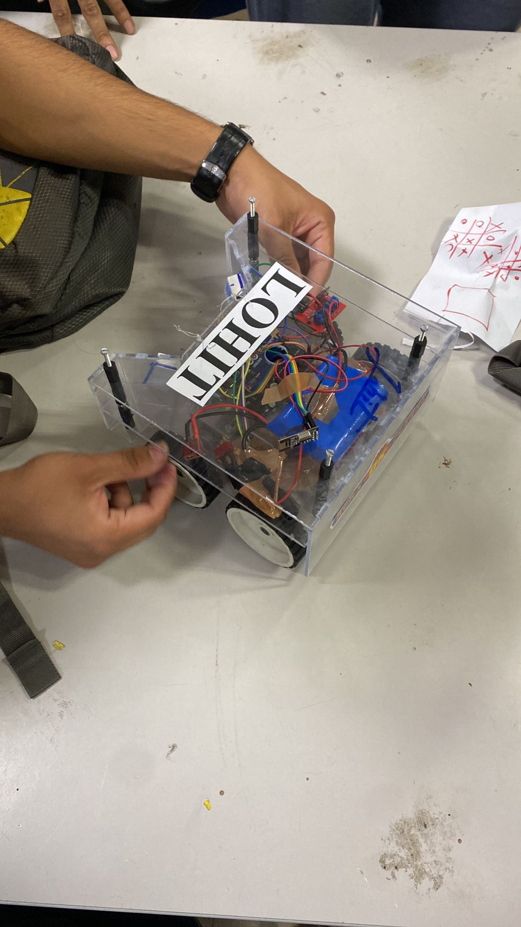
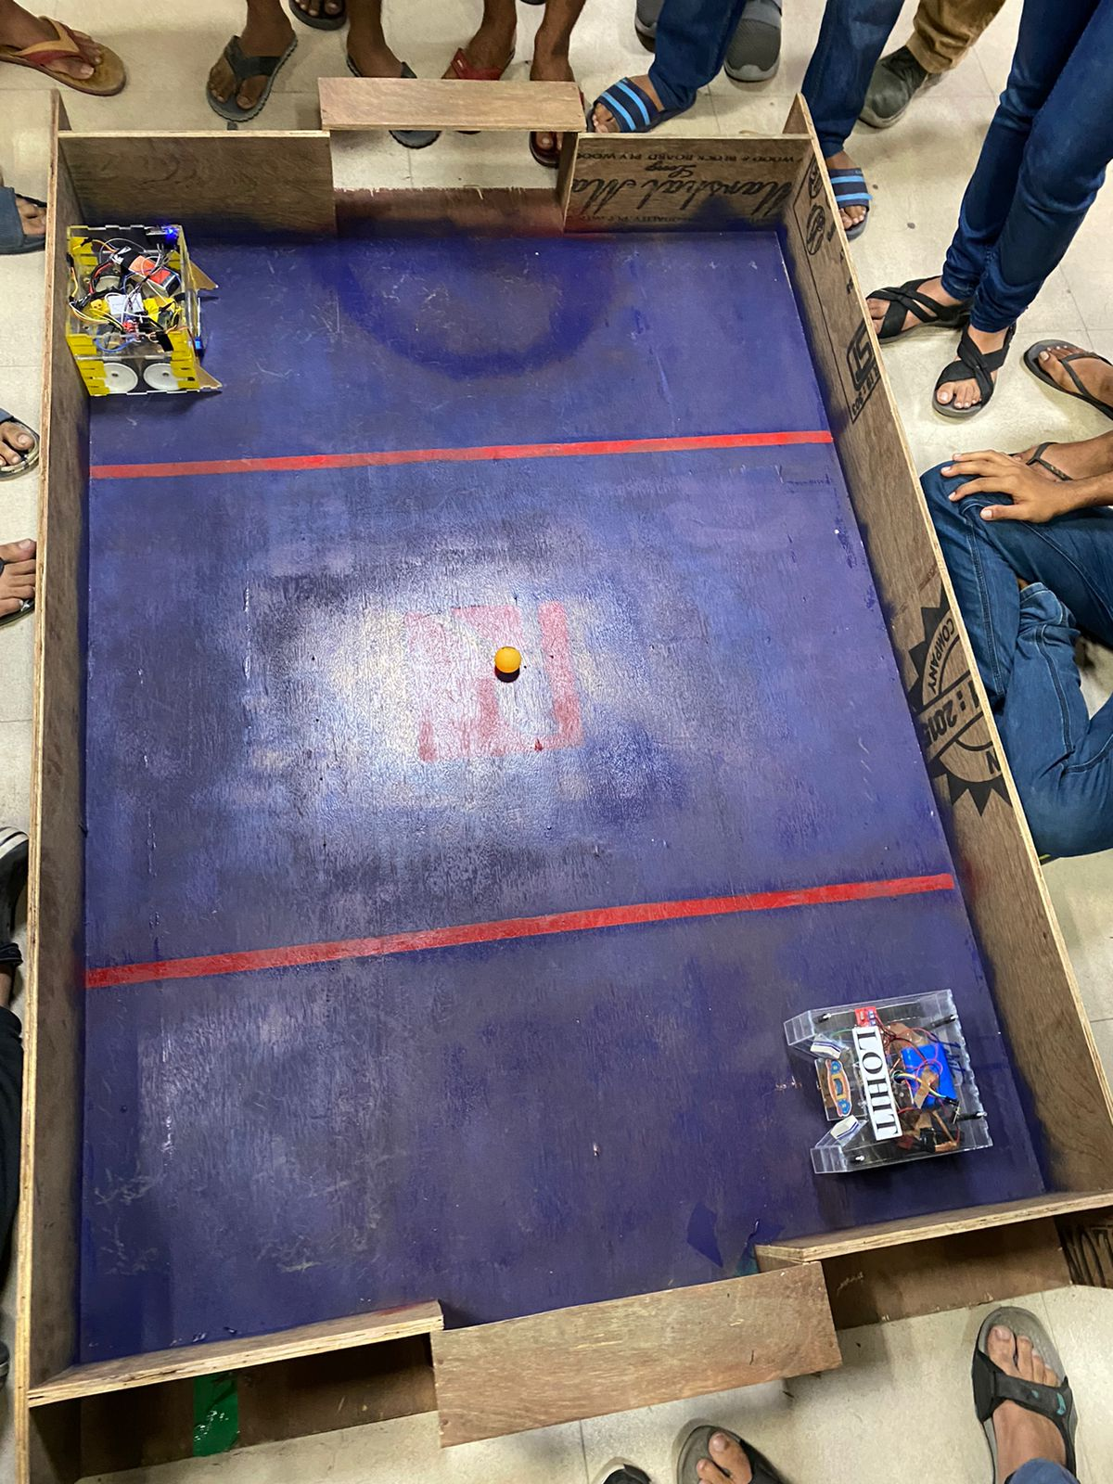
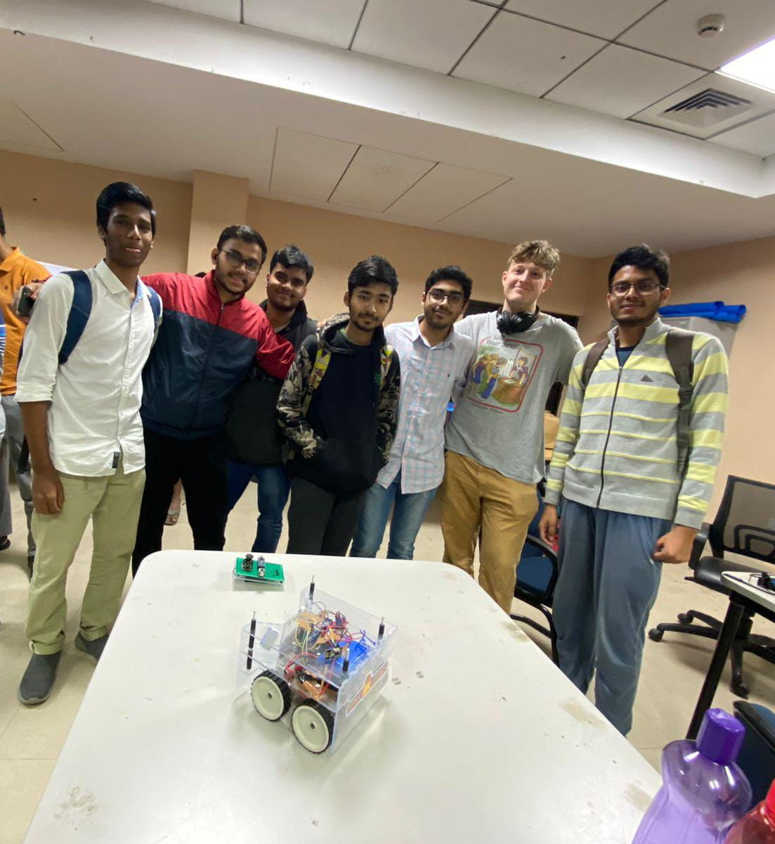
Original Pictures :
Our team

Slide 12
Problem Statement (Manipulator)
Problem Statement: We challenge you to design a movable robotic arm capable of picking up small objects and placing them at a different point.
Specifications of Bot:
There is no constraint on the size of arm.
A working gripper must be there to hold objects.
Bot should be able to move from one place to another using wheels.
The robot should have been fabricated, assembled by the team.
Readymade robots are not allowed.
Both, bots with a wired as well wireless control systems, are allowed.
Bot should not exceed 6 Kgs.
Task:
Your robotic arm has to pick the given object from given place, take it to the container placed at a distance and drop the object in the container. There will be 10 containers with different diameters of inlet. Diameter of containers will keep decreasing with each level. If bot accidentally drops object in between it will be given a chance to start over but if it drops the object while placing it in the container then it will be considered as a failed task and team will not be promoted to next round

Slide 13
Components used :
Robo-soccer
Arduino Nano
Wireless transceiver nRF24L01
Servos
Potentiometer
Lithium battery (12 V)
Jumpers
Acrylic sheet (3 mm)
Universal PCB board (8*12 cm) and breadboard
PS2 Joystick Module breakout sensor

Slide 14
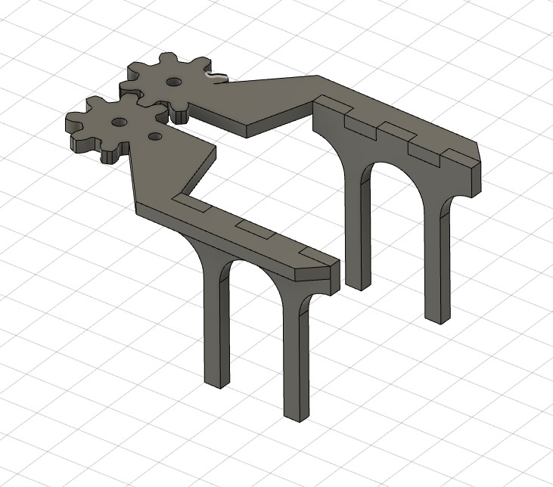
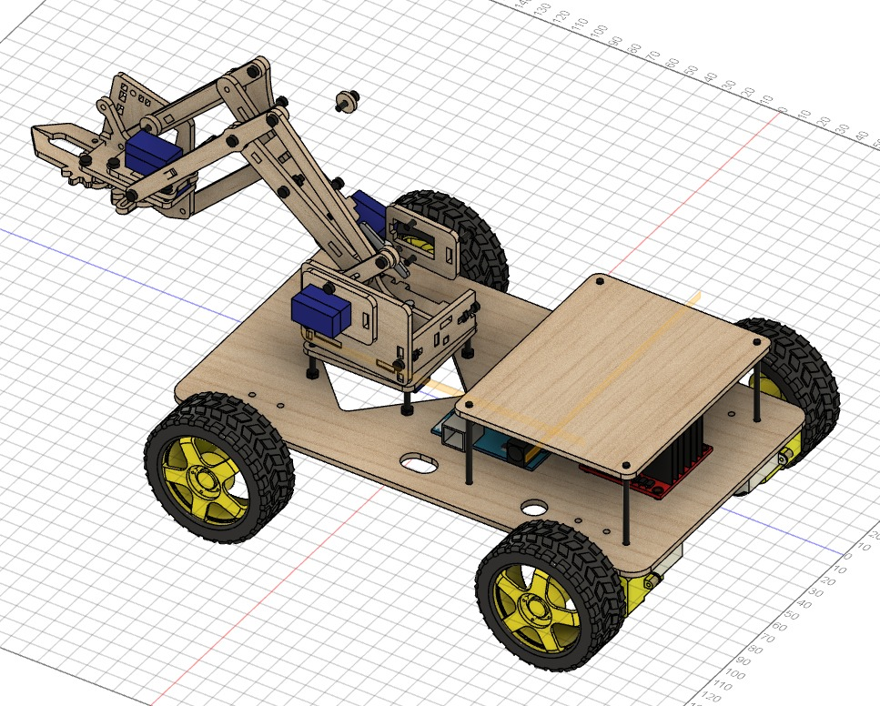
Proposed Design :

Slide 15
We transformed our Robo-soccer bot into Manipulator by making some changes in design and adding some extra features.
We mounted an arm on the moving bot(robo-soccer) that comprises of 4 servos and a jaw that is controlled by one of the servos.
These servos were controlled using potentiometer and again for communication we used Wireless transceiver nRF24L01 module.
The bot was able to hold objects of required dimension from ground and can lift it upto height of 80 cm and can travel with the object.

Slide 16
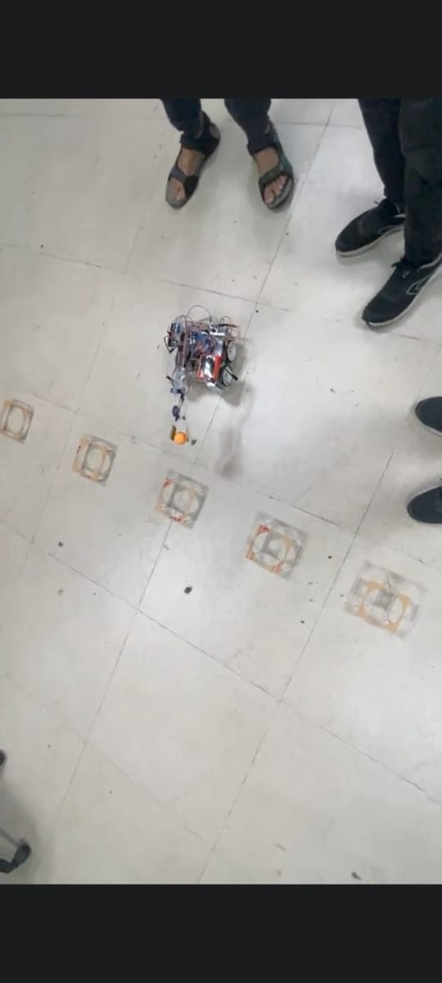
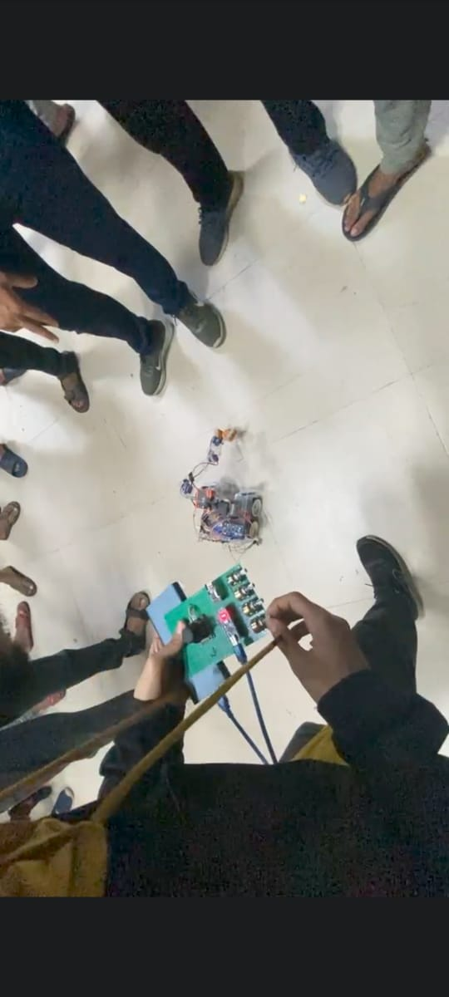
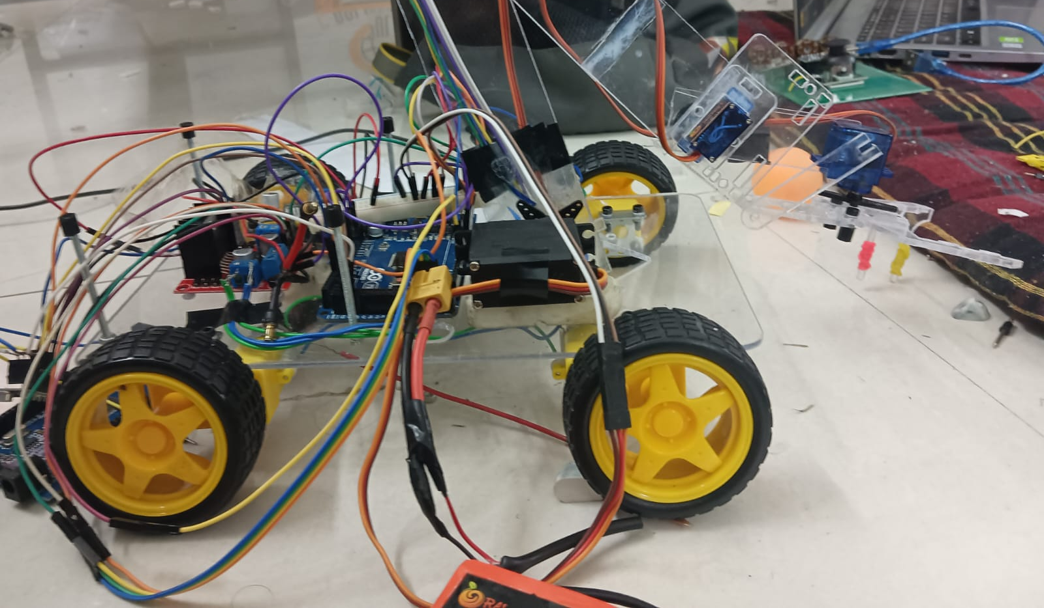
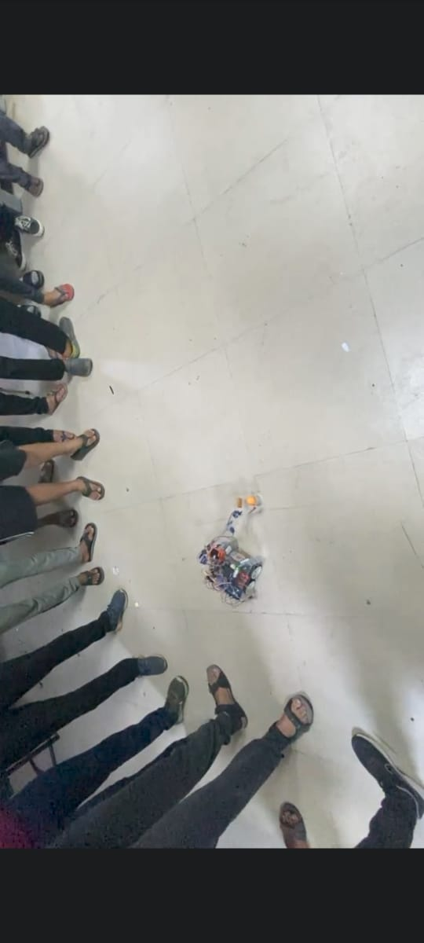
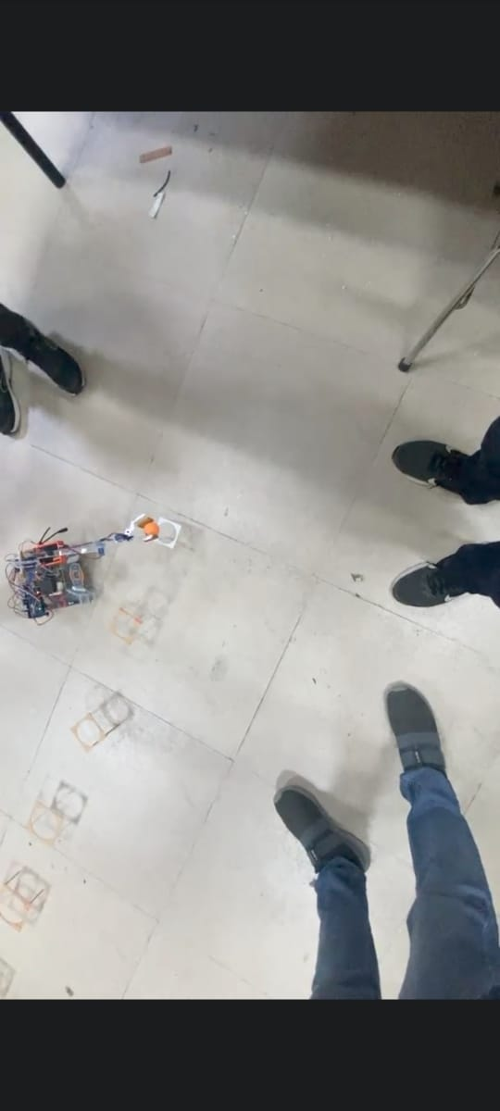
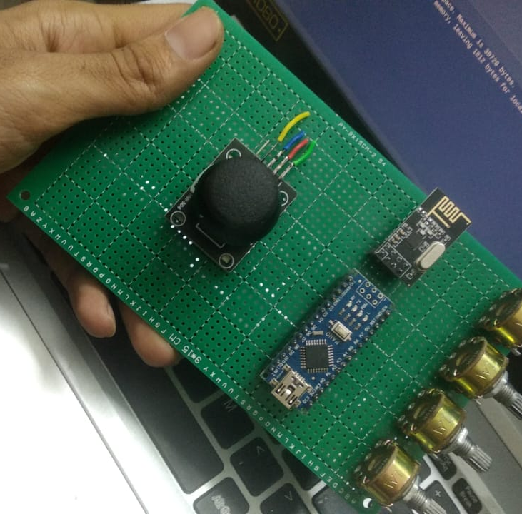
Original Pictures :

Slide 17

Thank You !!
We secured Gold Medal in both the problem statements

